Slide 1
SDS Machine Learning A-Z
subtitle

Slide 2
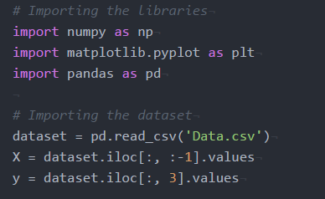
Import the Dataset
Python
Python uses an uder score, R uses a period

